Slide 1
E-Commerce Security
E-Commerce SE-413
Week 11
Notes:
1
1

Slide 2
Stopping the E-Crimes
Why is it difficult for e-tailers to stop cyber criminals and fraudsters:
Strong EC security makes online shopping inconvenient for customers
Lack of cooperation from credit card issuers and foreign ISPs
Online shoppers do not take necessary precautions to avoid becoming a victim
IS design and security architecture are vulnerable to attack
Software vulnerabilities (bugs) are a huge security problem
Managers sometimes ignore due standards of care

Slide 3
Stopping the E-Crimes
Due Care
Care that a company is reasonably expected to take based on the risks affecting its EC business and online transactions.
Exposure
The estimated cost, loss, or damage that can result if a threat exploits a vulnerability
Vulnerability and Risk
CVE
(cve.mitre.org)

Slide 4
Threat Probability and Severity

Slide 5
Requirements for EC Security

Slide 6
Security Policy
A security policy is a written statement describing
which assets to protect.
why they are being protected.
who is responsible for that protection.
which behaviors are acceptable and which are not.
A security policy should
Address physical security, network security, access authorizations, virus protection, and disaster recovery
Be regularly reviewed and updated.

Slide 7
Security Policy Constituent
Authentication
Who is trying to access the site?
Access control
Who is allowed to log on to and access the site?
Secrecy
Who is permitted to view selected information?
Data integrity
Who is allowed to change data?
Audit
Who or what causes specific events to occur, and when?

Slide 8
Essentials of Security
Policy
Equipment
Human Resources

Slide 9
Measures of Security
Physical
Restrict access to physical equipment
Logical
Restrict access to logical resources

Slide 10
Physical Security
Access Control
ACL (Access Control List)
Measures
Time Control & Monitoring
Key or Code
Multi-key/Multi-code Access
Human Feature Scan
Iris or Thumbnail
Geo Fencing through e-Tags

Slide 11
Logical Security
Resources under Threat
Application
Device
Network
Application Level Security
2FA
Using Secure Communication Channel (HTTPS)
PCI DSS Compliance
Password Managers
Reliable Service Provider

Slide 12
Logical Security
Device Level
Biometric
Remote Locking
Anti malware
Encrypted Drives
Network Level
IDS
Firewalls
Honeypots / Honeynets
Private Networks
Bastion Gateway

Slide 13
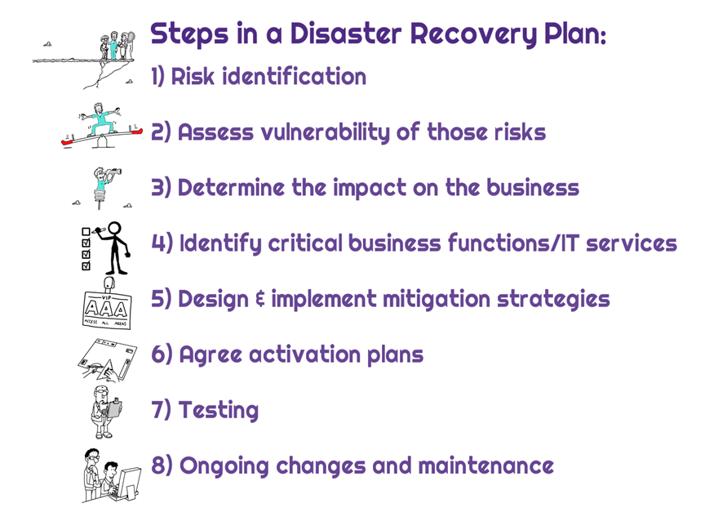
Disaster Management Plan
Important for all categories of business (SML).

Slide 14
EC Owner Responsibilities
https://www.cloudways.com/blog/ecommerce-security-tips/

